Slide 1
Eyeball Controlled Automatic Car

Slide 2
PREPARED BY:
Abdallah Akram

Slide 3

ABSTRACT
Wireless intelcar is designed to help the paralysed person who moves on a car, the car will automatically move to a particular direction as the patient moves his eyes towards a direction, with the help of Eye ball movement detection camera.

Slide 4
System Process
Camera
CPU
Bluetooth
Microcontroller
Motor Driver
DC Motor
Face Detection
Detect person face
Crop the face
Eye Detection
Detect the eye
Extract the eye
Eyeball Movement
Detect eyeball movement
Detect direction of eyeball

Slide 5
Hardware Requirement
Processor (for image processing)
Arduino Uno (Microcontroller)
Bluetooth Module
Camera
Motor Driver
Dc Motors
Batteries

Slide 6
Image Processing
Image processing is a method to convert an image into digital form and perform some operations on it, in order to get an enhanced image or to extract some useful information from it.

Slide 7
Image Processing
Image processing basically includes the following three steps
Importing the image with optical scanner or by digital photography.
Analyzing and manipulating the image which includes data compression and image enhancement and spotting patterns that are not to human eyes like satellite photographs.
Output is the last stage in which result can be altered image or report that is based on image analysis.

Slide 8

Arduino Uno
The Arduino Uno is a microcontroller board based on the ATmega328. It has 14 digital input/output pins (of which 6 can be used as PWM outputs), 6 analog inputs, a 16 MHz ceramic resonator, a USB connection, a power jack, an ICSP header, and a reset button.
specification
Microcontroller : ATmega328
Operating Voltage : 5V
Input Voltage : 7-12V
Digital I/O Pins : 14 (of which 6 provide PWM output)
Analog Input Pins : 6
DC Current per I/O Pin: 40 mA
Flash Memory : 32 KB
SRAM : 2 KB
Clock Speed : 16 MHz

Slide 9
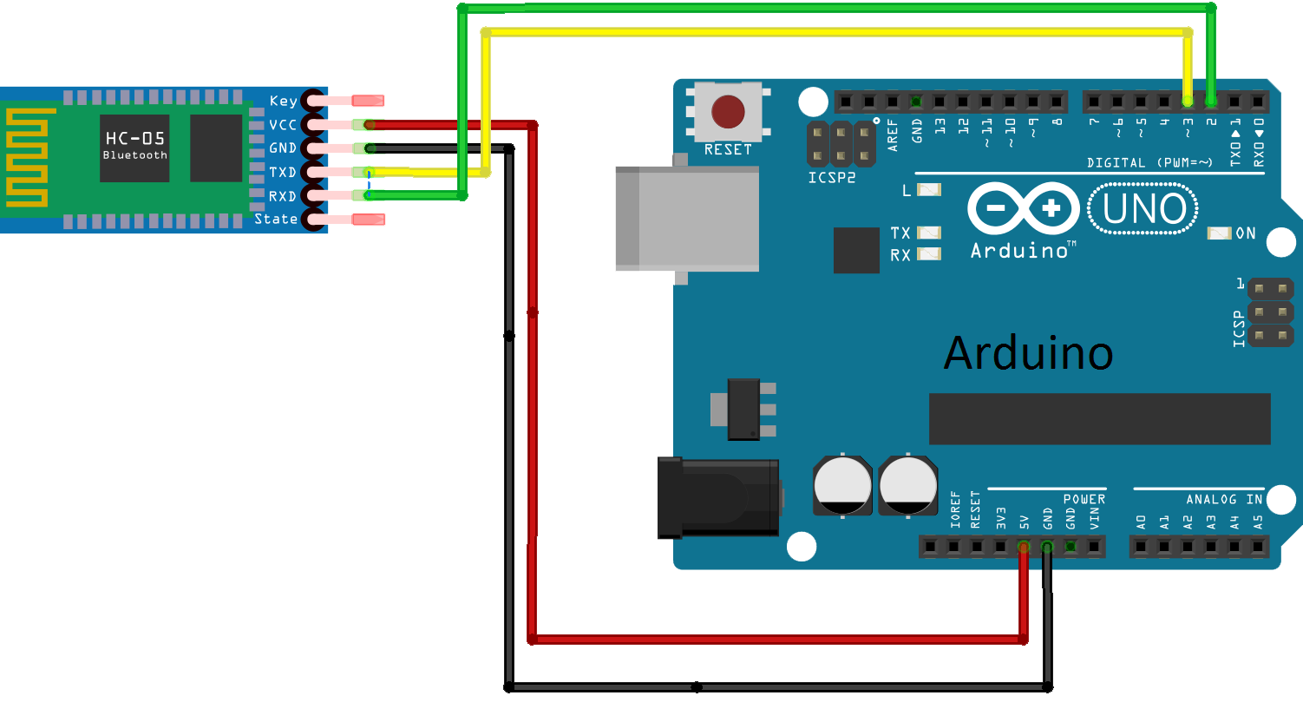
Bluetooth Module HC-05

Slide 10
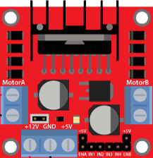
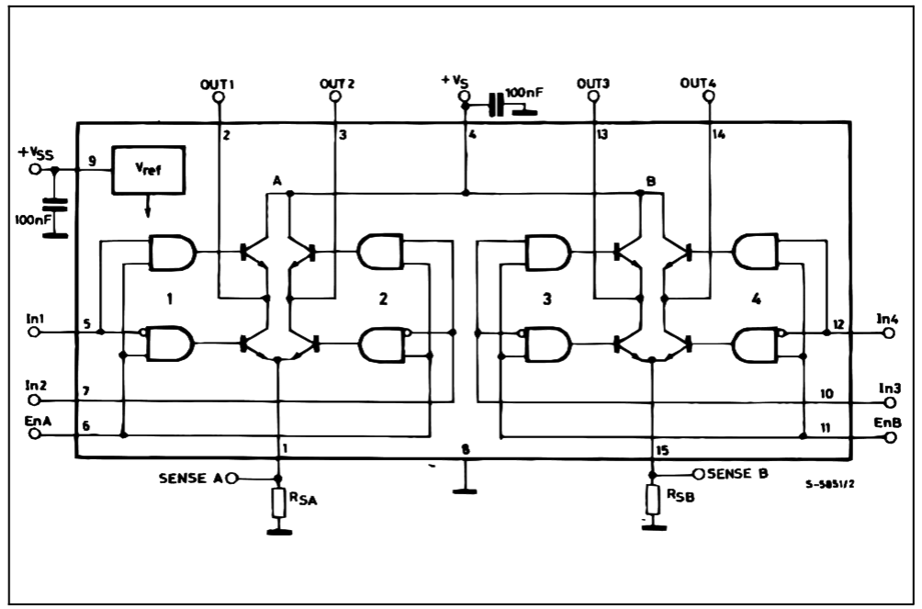
Motor Driver L298
L298 Motor Driver is dual H-Bridge driver

Slide 11
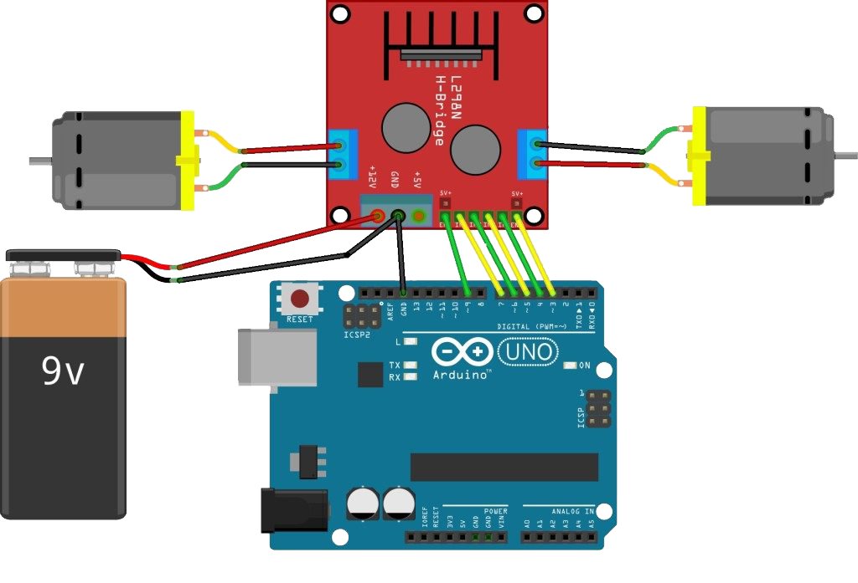
L298 Connected with Arduino

Slide 12
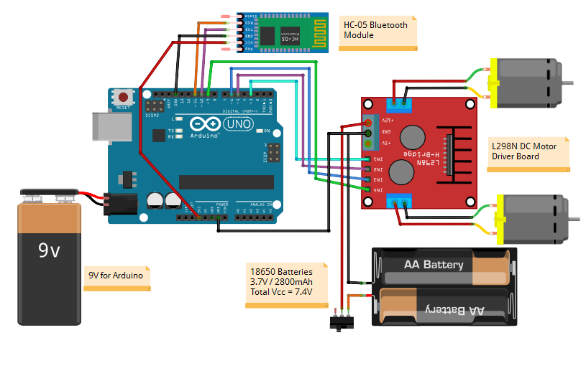
L298 & HC-05 Connected with Arduino

Slide 13
Components Price
Arduino uno | 140 L.E
L298 Motor Driver | 45 L.E
HC-05 Bluetooth Module | 115 L.E
4 DC Motor With Wheel | 180 L.E
Robot chassis | 80L.E
Battery 6.3 Volt | 75L.E
2 Battery 3.7 Volt | 70L.E

Slide 14
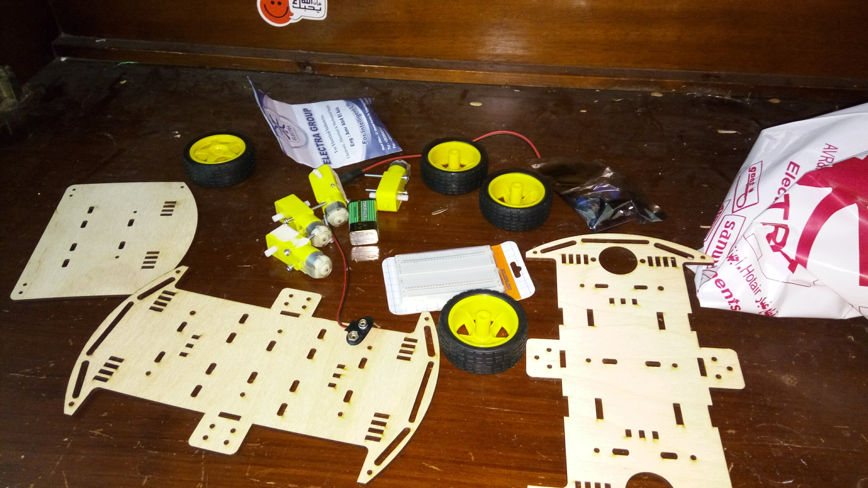
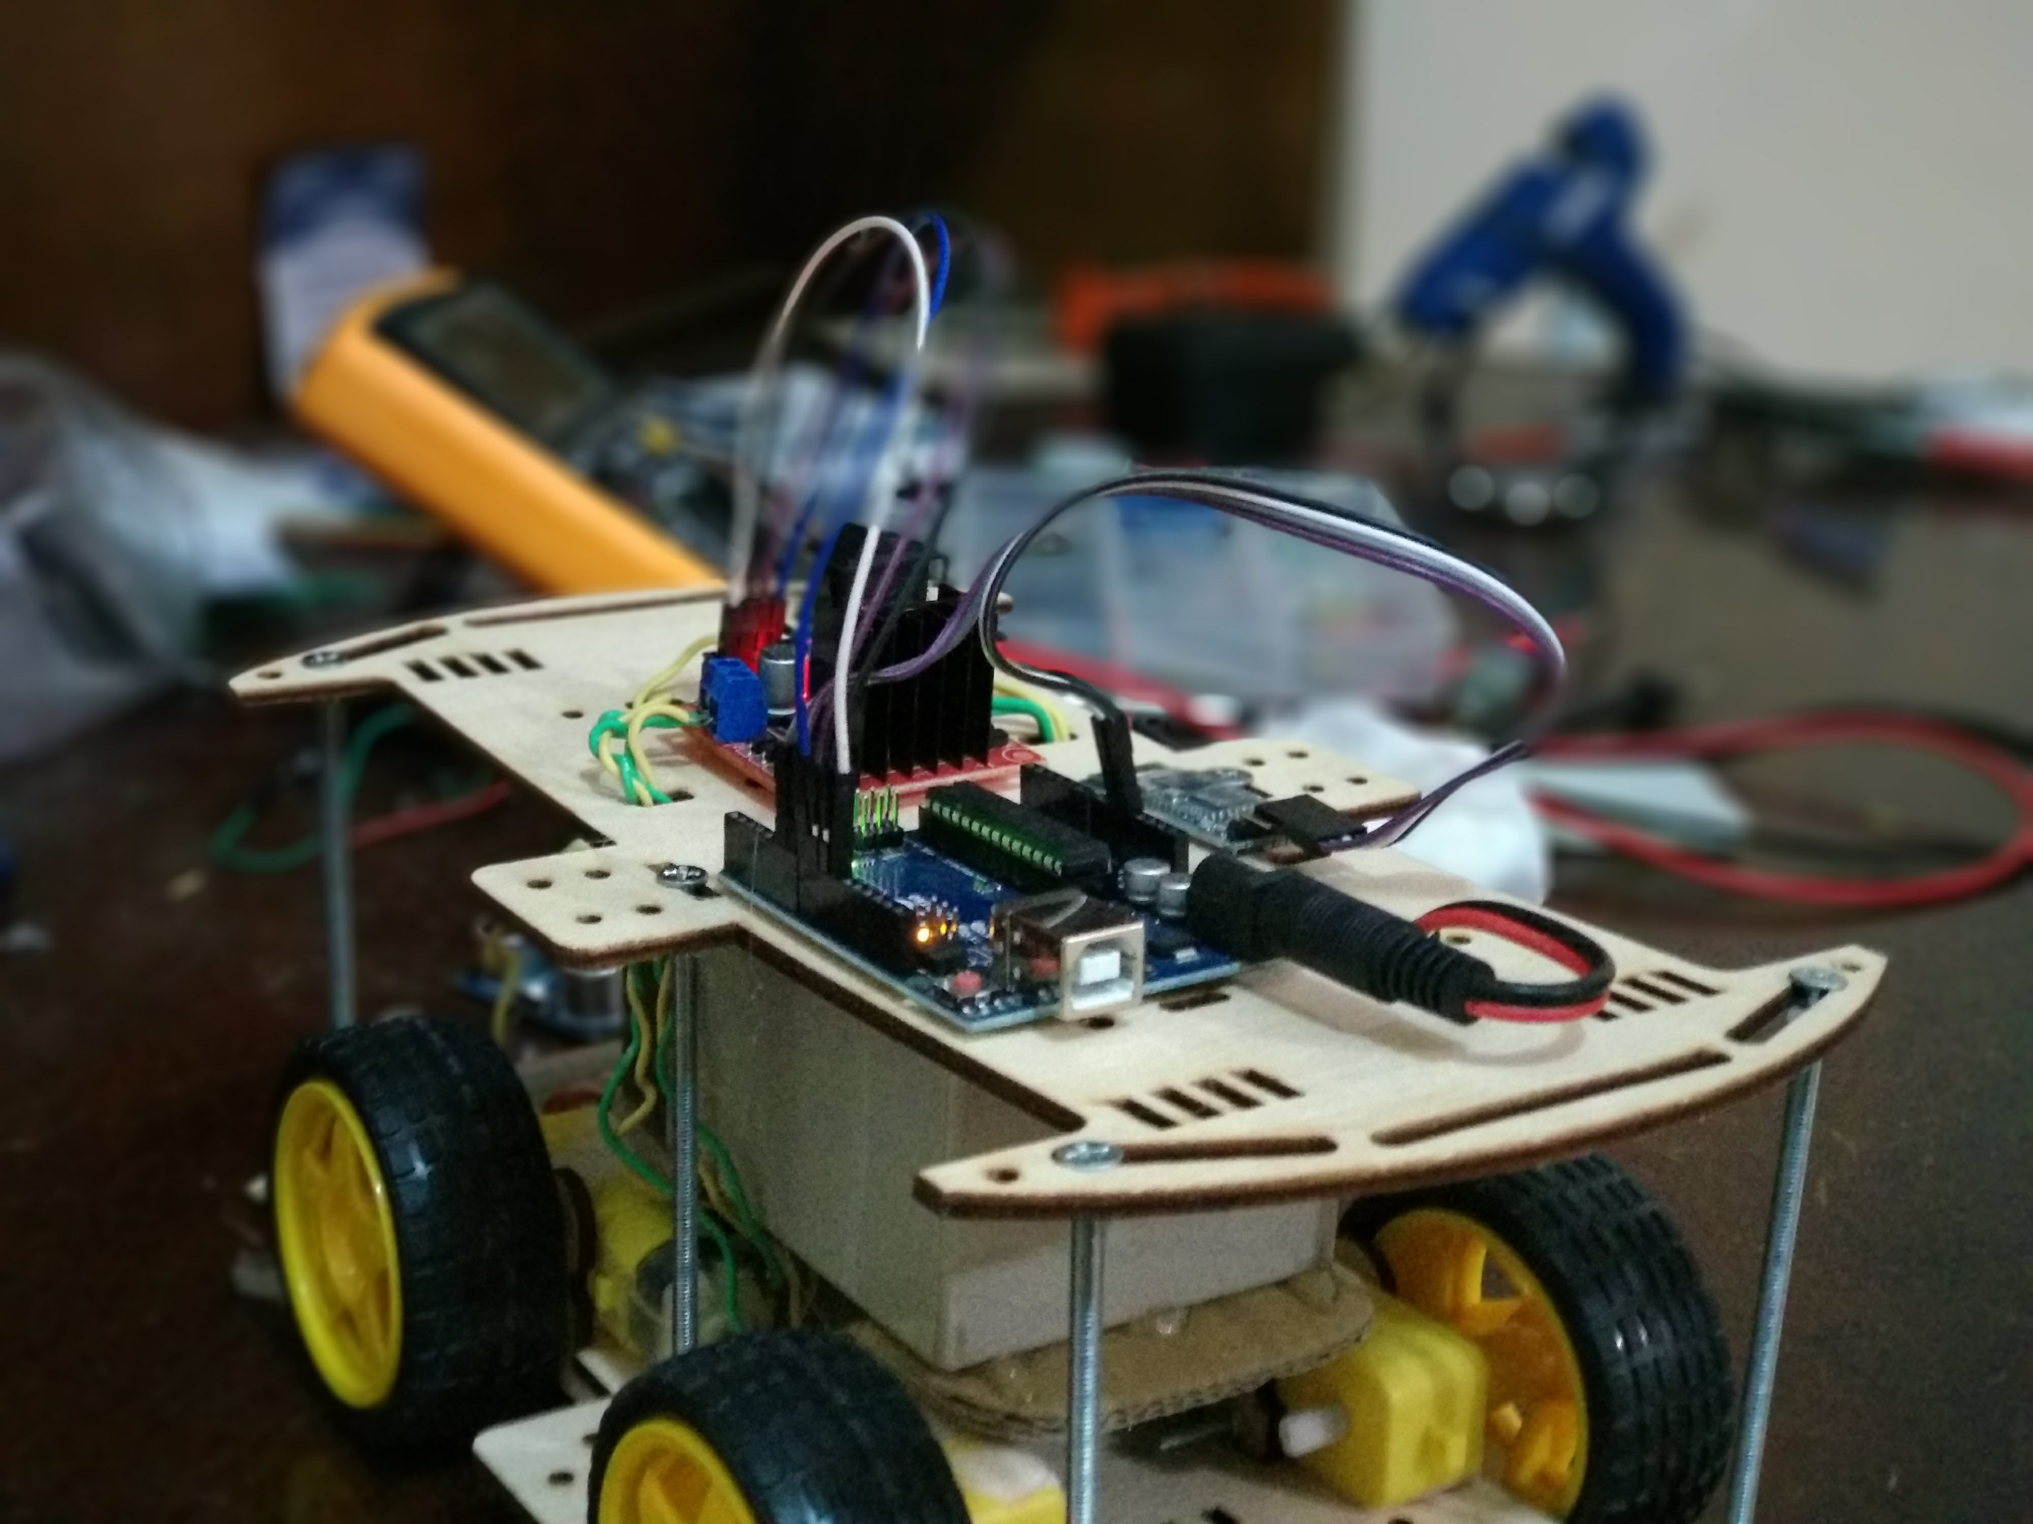
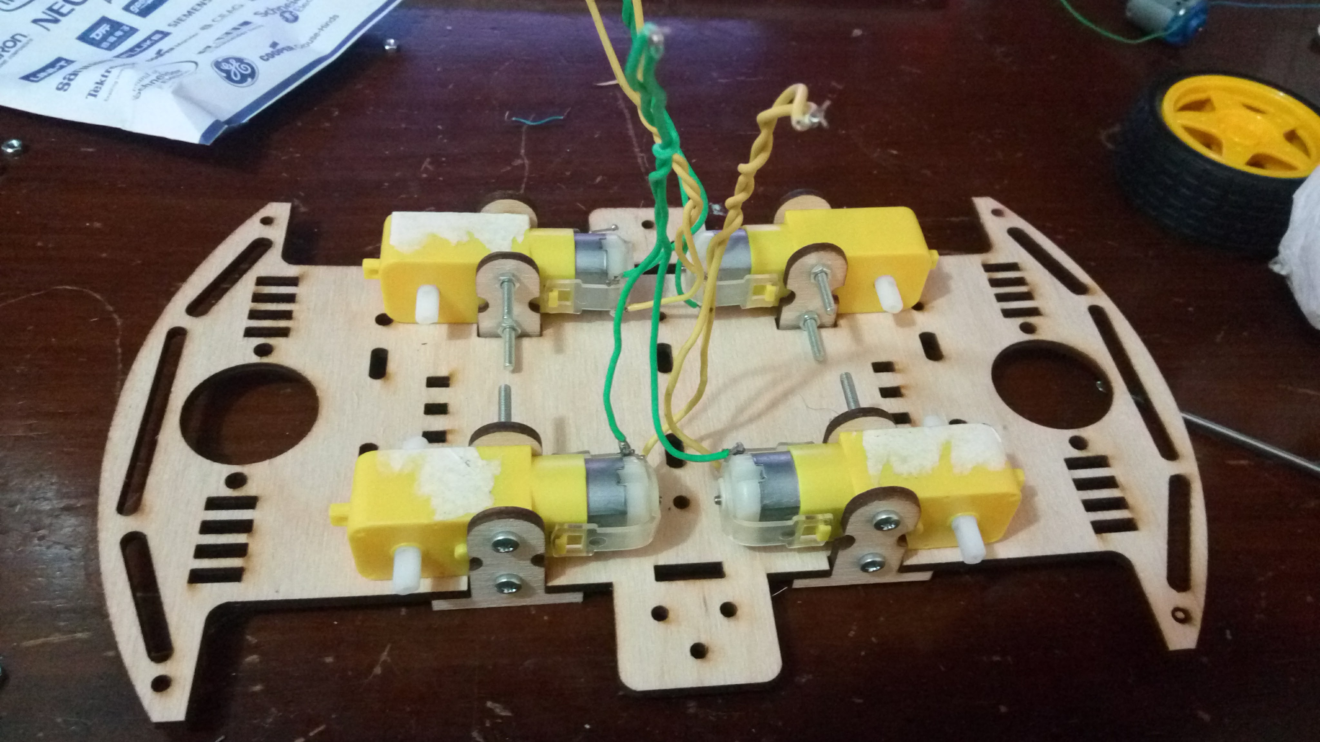
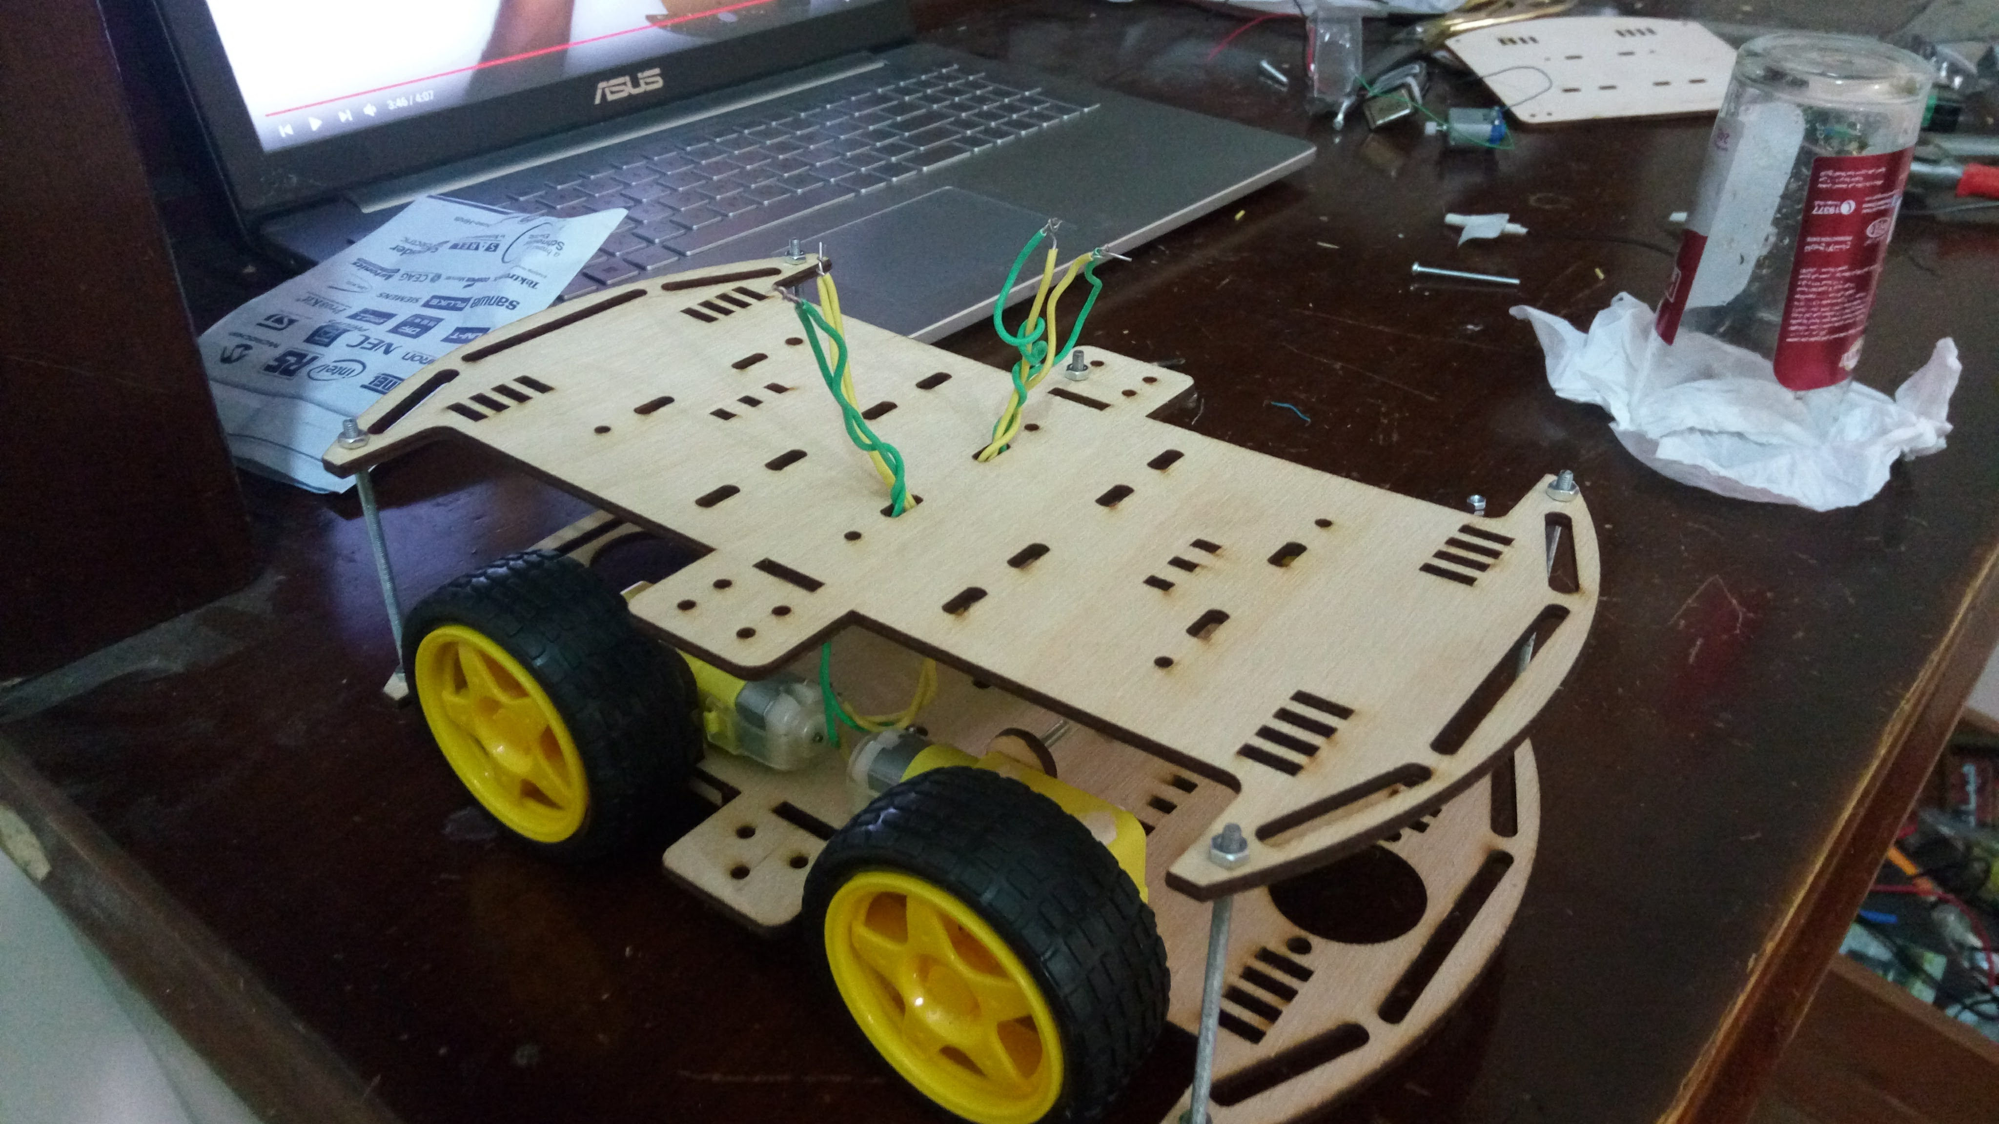
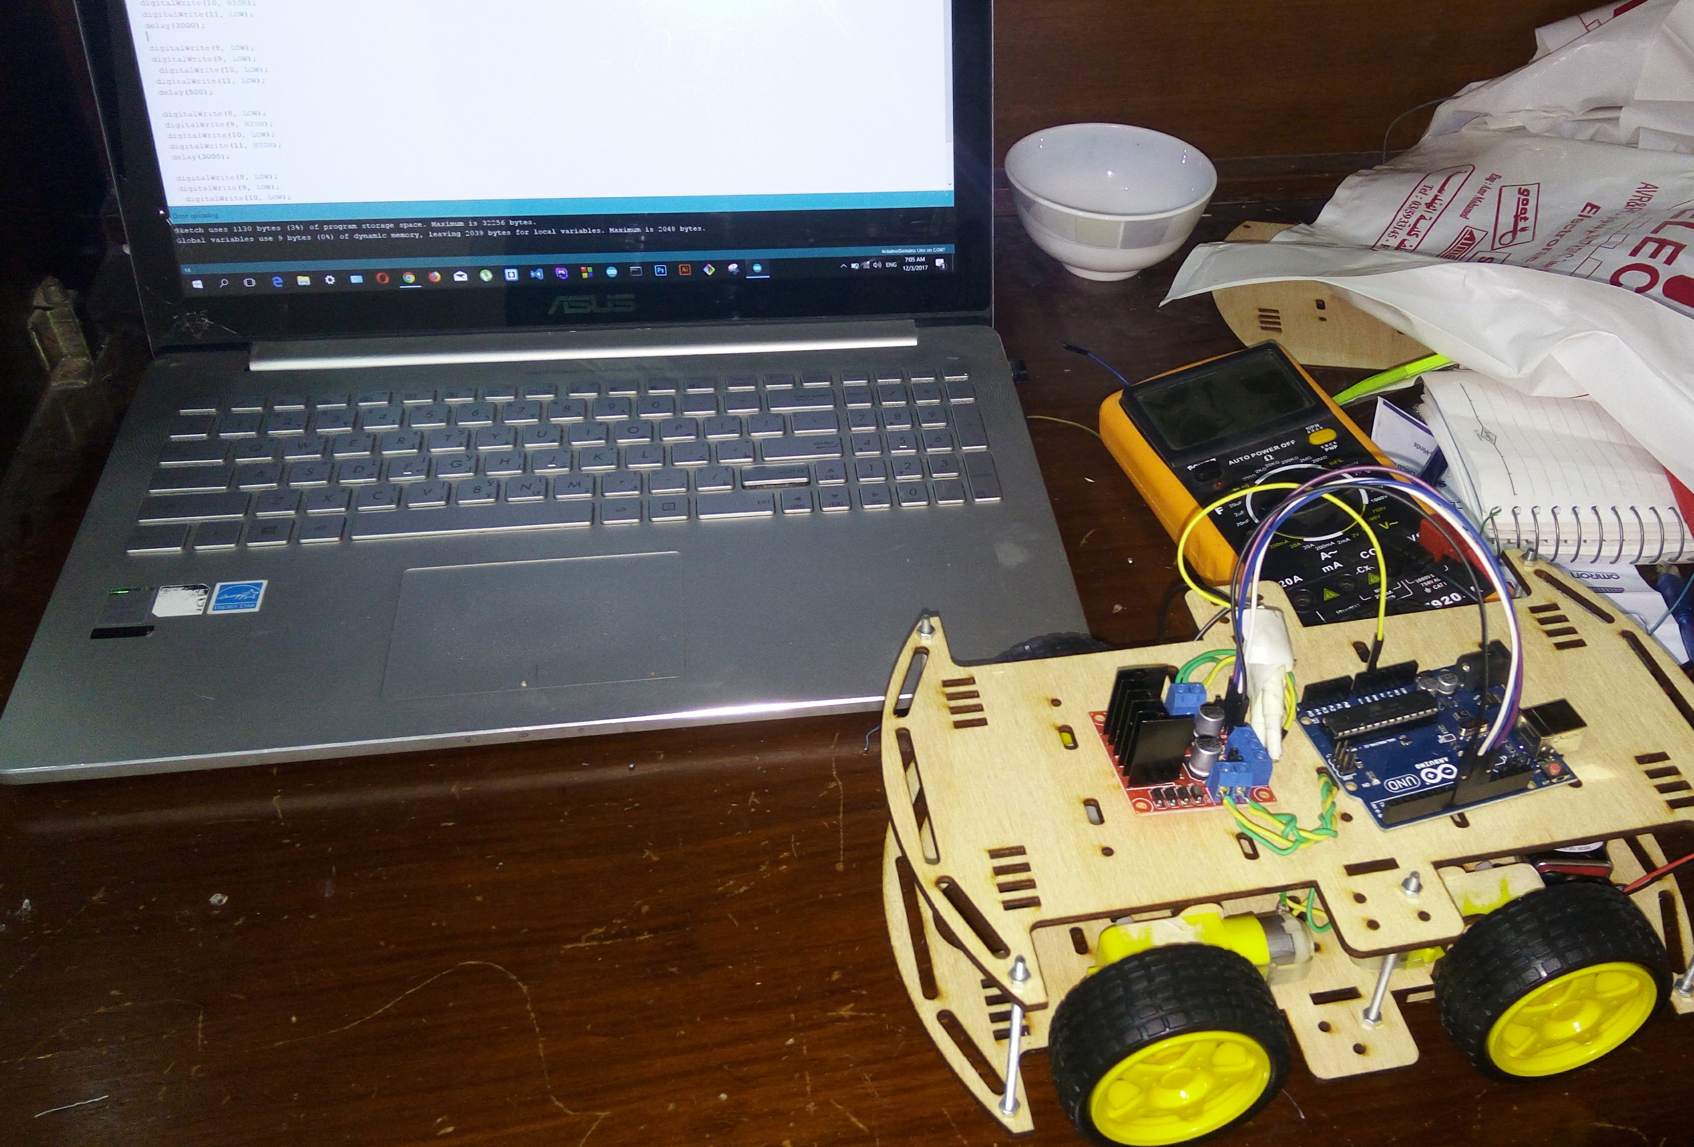
Robot Assemble And Setup

Slide 15
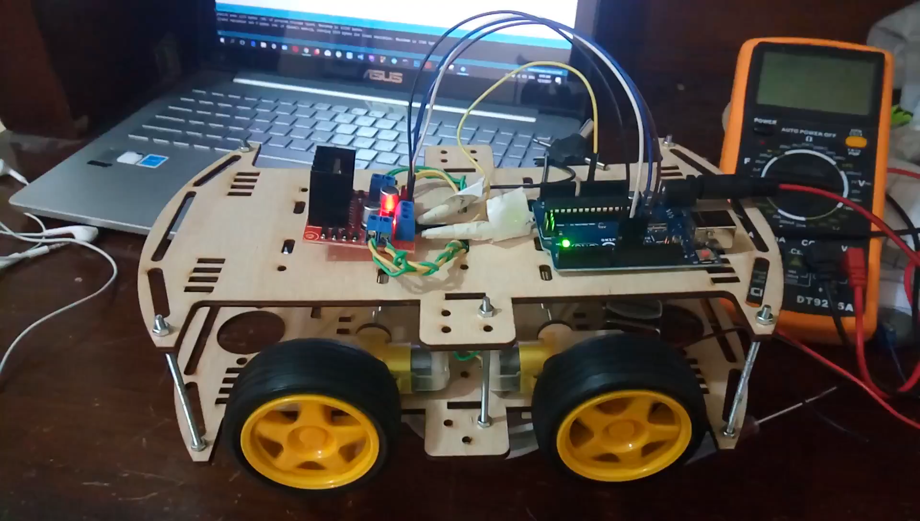
Testing project

Slide 16
Thanks!

